Slide 1
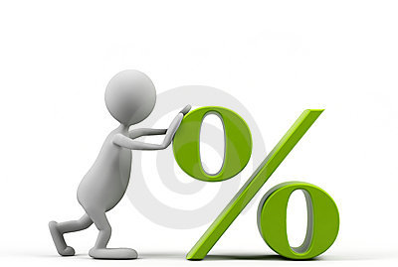


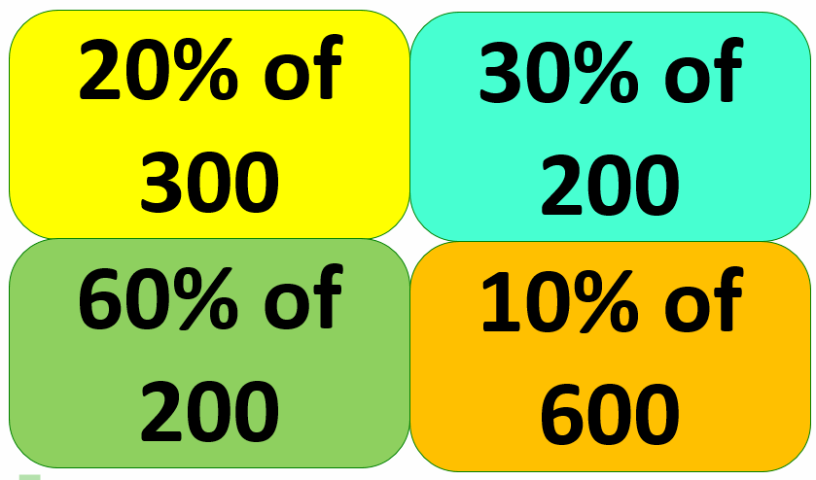
Keywords
Increase
Percent (%)
Fractions
Hundred
Parts
EQ: How do I increase a percentage of an amount?
DATE
Percentage Increase
STARTER
15% of 300km
5% of 700ml
25% of 560kg
95% of £8
Find the Odd One Out
Depth
How can you find 35% of £2.50?

Slide 2
Contents
Glossary or Formula Page
Page
Date
Essential Question
24
7
30
Word or Formula
Definition or Example

Slide 3
Tasks
24
7
30
Topic
Essential Question
Questions
Notes
Summary
1
2

Slide 4
EQ: How do I increase a percentage of an amount?
Understanding
We can represent percentage change using bars.
The original whole amount, 100% looks like this:
100%
120%
120% is 20% longer as we have added 20% on to 100%
A 20% increase makes the item 20% larger
This would be called “a 20% increase”

Slide 5

EQ: How do I increase a percentage of an amount?
Example
Steve, who was on a salary of $20,000 per year,
was given a pay rise of 7%. What is Steve’s new salary?
STEP 1:
Without a calculator work out what 7% of $20,000 is
7% = 5% + 1% + 1%
7% = 1,000 + 200 + 200
7% = 1,400
STEP 2:
Depth:
Think about…
How would you calculate 7% using a calculator?
Add this to Steve’s original salary
$20,000 + $1,400 =
$21,400

Slide 6
LO: Percentage increases
Fluency and Understanding
A chair costs $20.00 excluding GST. How much will it cost including GST which is 10%?
100% = $20.00
10% = $2
100% + 10% = $20.00 + $2
= $22.
Notes:
Go through in real time

Slide 7
EQ: How do I increase a percentage of an amount?
Fluency and Understanding
A 140g chocolate bar is increased by 15% calculate its new weight
15% of 140g= 21g
15% extra free
140g + 21g= 161g
Notes:
Go through in real time

Slide 8
EQ: How do I increase a percentage of an amount?
Hinge Questions
(a)
£60 is increased by 20%
(b)
120kg is increased by 17.5%
10% = £6
10% = 12kg
x2
x2
÷2
÷2
5% =
£12
6kg
20% =
÷2
÷2
2.5% =
3kg
We now need to increase £60 by £12
17.5% =
21kg
£72
We now need to increase 120kg by 21kg
£60 + £12 =
120kg + 21kg =
141kg
Notes:
If have higher and all correct ignore F&U and go onto C&R

Slide 9
EQ: How do I increase a percentage of an amount?
Fluency and Understanding
Work out the final amount when:
(a)
$40 is increased by 10%
(b)
£120 is increased by 20%
10% = $4
10% = $12
$44
x2
x2
$40 + $4 =
$24
20% =
$120 + $24 =
$144
(c)
$240 is increased by 35%
(d)
£6.80 is increased by 17.5%
10% = $24
10% = $0.68
x3
x3
÷2
÷2
5% =
30% =
$0.34
$72
÷2
2.5% =
÷2
5% =
$0.17
$12
$84
35% =
$1.19
17.5% =
$324
$7.99
$240 + $84 =
$6.80 + $1.19=

Slide 10
EQ: How do I increase a percentage of an amount?
Connections and Reasoning
A teacher’s starting salary for is $21500. This increases by 2% every year. What will the teacher’s wage be after 3 years?
$22,815.97

Slide 11
EQ: How do I increase a percentage of an amount?
Connections and Reasoning
A 900ml bottle of Tres-Foamy shampoo increases by 20% in size. Harry’s shampoo company increases its 1000ml bottles by 7%.
Which company’s shampoo bottle is now largest?
Your communication with be taken into consideration.
Tres – 1080ml
Harry – 1070ml
Therefore, Tres-Foamy now has the larger bottle as it holds 10ml more than Harry’s

Slide 12
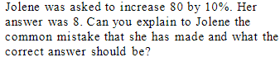
EQ: How do I increase a percentage of an amount?
Reasoning
Jolene found 8% she forgot that when increasing it had to be added back onto the original amount.

